Slide 1
EE 210
LECTURE 4-PART 2
TECHNIQUES OF CIRCUIT ANALYSIS
Cenk Efeler
Reference Book :Electric Cırcuits
James W.Nielson & Susan A.Riedel

Slide 2
THE NODE-VOLTAGE METHOD VERSUS THE MESH- CURRENT METHOD
When is the node-voltage method preferred to the mesh-current method and vice-versa?
There is no clear answer,however,the following questions help identify the more efficient method.
Does one of the methods result in fewer simultaneous equations to solve ?
Does the circuit contain supernodes ? If so,using the node-voltage method will permit you to reduce the number of equations to be solved.
Does the circuit contain supermeshes ? If so,using the mesh-current method will permit you to reduce the number of equations to be solved.
Will solving some portion of the circuit give the requested solution?If so,which method is most efficient for solving just the pertinent portion of the circuit?

Slide 3
Example 4.6 & 4.7

Slide 4
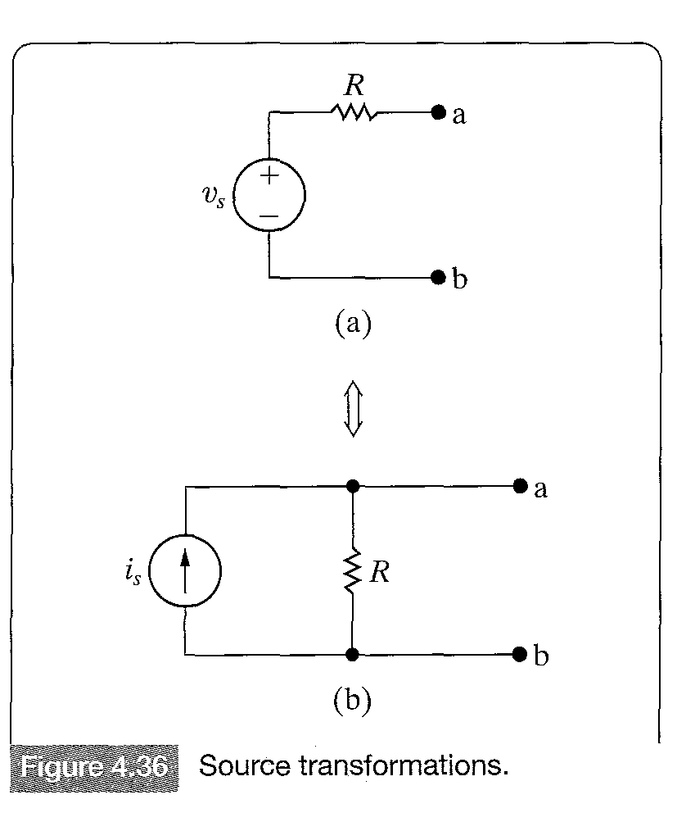
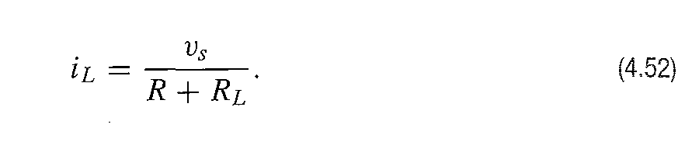
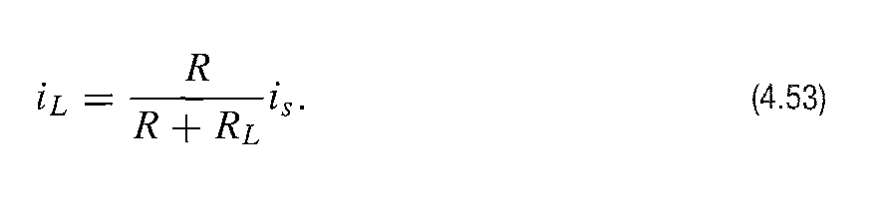
SOURCE TRANSFORMATIONS
A voltage source in series with a resistor can be replaced by a current source in parallel with the same resistor or vice versa.
Suppose RL is connected between
nodes a and b of circuit 4.36 a.
Using Ohm’s law the current
through RL is
And now suppose the same resistance is connected between the nodes a,b of the circuit 4.36 b the current through RL becomes:

Slide 5
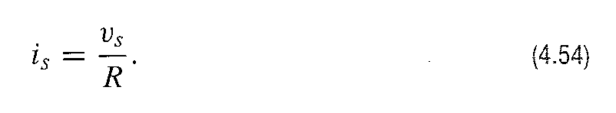
SOURCE TRANSFORMATIONS
If the two circuits are equivalent,these currents through the load resistance RL must be the same.
Equating the right-hand sides of equations 4.52 and 4.53 and simplifying
When Equation 4.54 is satisfied for the circuits in 4.36,the current in RL must be the same for all values of RL,then the voltage drop across RL is the same in both circuits and the circuits are equivalent at nodes a,b.If the polarity of vs is reversed,the orientation of is must be reversed to maintain equivalence.

Slide 6
SOURCE TRANSFORMATIONS
Example 4.8 & 4.9

Slide 7
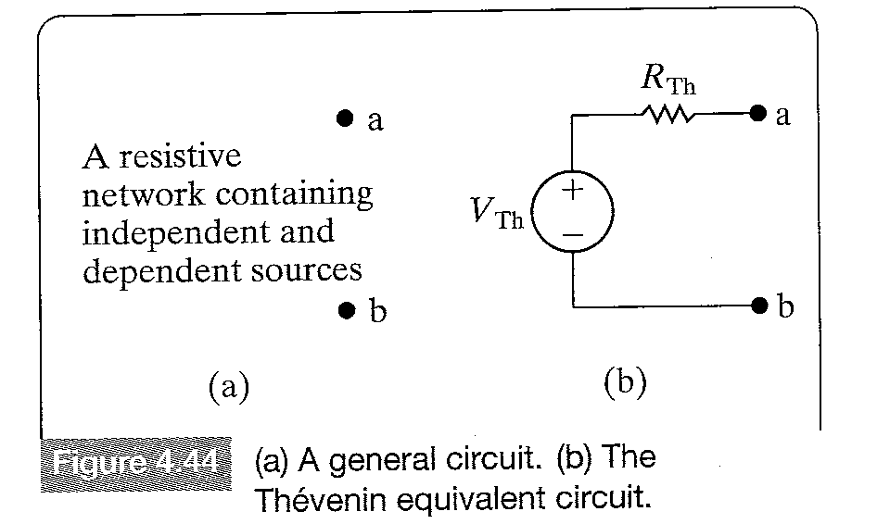
THEVENIN & NORTON EQUIVALENT CIRCUITS
A circuit used to illustrate a Thevenin Equivalent
A Thevenin equivalent circuit is an independent voltage source VTh (VThevenin) in series with a resistance RTh (RThevenin) which represents the interconnection of parallel and series resistances.
This series combination of the voltage and resistor is equivalent to the original circuit in the sense that when any load resistance is connected between the terminals a,b both the original circuit and the Thevenin equivalent circuit produce the same voltage between terminals a,b the same and current through the terminals ab.

Slide 8
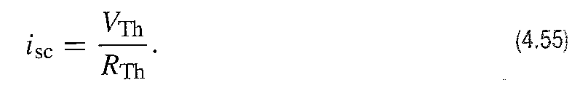
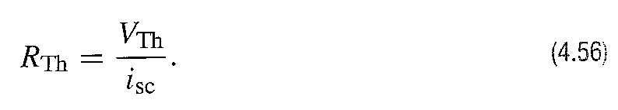
THEVENIN & NORTON EQUIVALENT CIRCUITS
To determine the Thevenin equivalent circuit we need to determine both VTh and RTh.
VTh is equal to the open circuit voltage when no load is connected between the terminals a,b.
Rth is equal to the ratio of the VTh to the current when a short circuit is placed between the terminals a,b.

Slide 9
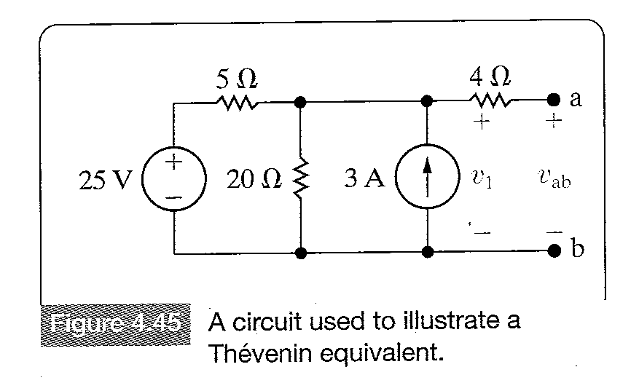

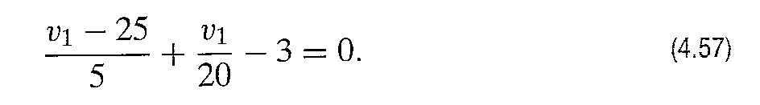
FINDING THE THEVENIN EQUIVALENT
To find the Thevenin equivalent circuit of the circuit 4.45,we first calculate the open circuit voltage vab.When the terminals are open there is no current in the 4 resistor. Therefore,the open-circuit voltage vab is identical to the voltage across the 3A current source,labeled v1.v1 is found by solving a single node-voltage equation,choosing the lower node as the reference node.

Slide 10

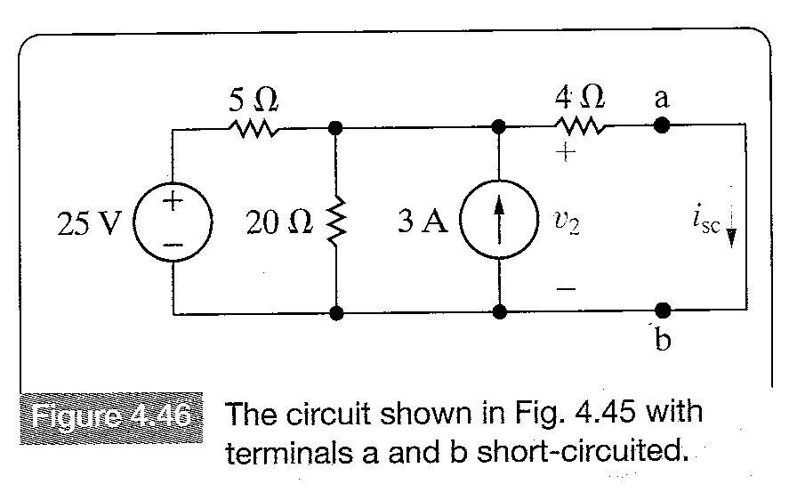
FINDING THE THEVENIN EQUIVALENT
Solving for V1 yields
The next step is to place a short circuit across the terminals and calculate the resulting short-circuit current.Figure 4.46 shows the circuit with the short in place.
Once v2 is calculated,the
short circuit current (isc)
can be calculated.

Slide 11
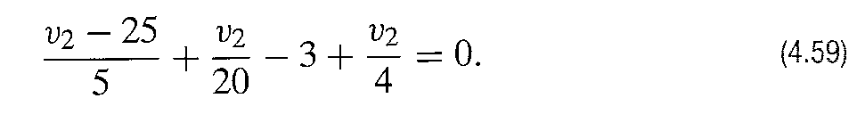
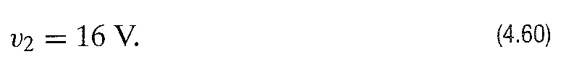
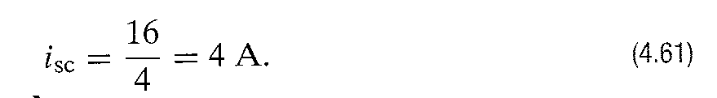
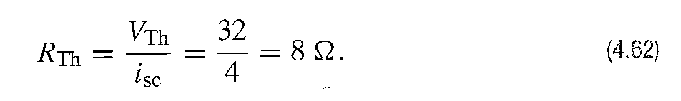
FINDING THE THEVENIN EQUIVALENT
Using the lower node as the reference node
Solving Equation 4.59 for v2 gives
Hence the short circuit current is
The Thevenin resistance is found by substituting results from Equations 4.58 and 4.61 into Equation 4.56

Slide 12
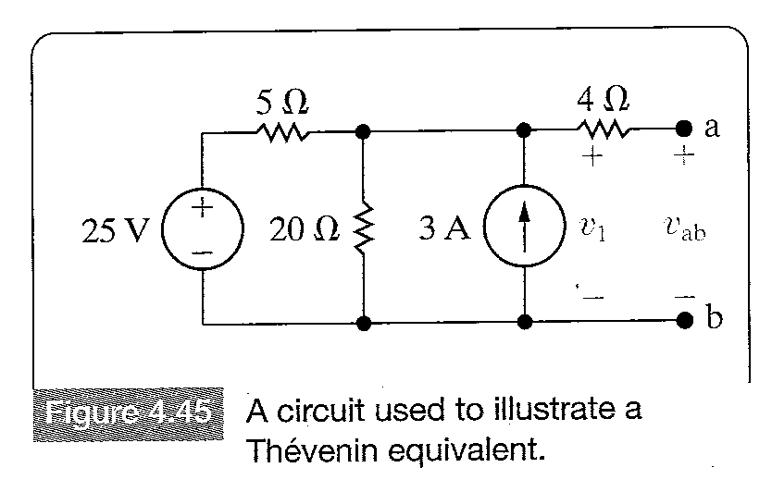
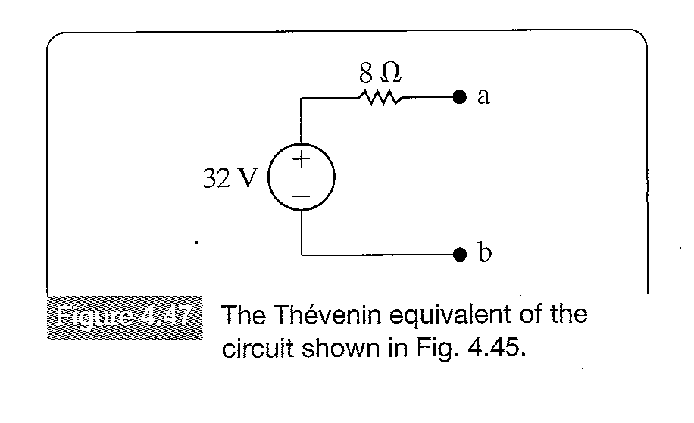
FINDING THE THEVENIN EQUIVALENT
Figure 4.47 shows the Thevenin equivalent circuit for the circuit shown in Figure 4.45.For any resistor value connected between the terminals a,b of both Figure 4.45 and 4.47,the voltage between the terminals a,b and the current through the terminals a,b are equal

Slide 13
NORTON EQUIVALENT CIRCUITS
A Norton equivalent circuit consists of an independent current source in parallel with the Norton equivalent resistance.The Norton equivalent circuit can be derived from a Thevenin equivalent circuit , simply by making a source transformation.Thus the Norton current equals the short-circuit current at the terminals of interest,and the Norton resistance is identical to the Thevenin reistance.

Slide 14
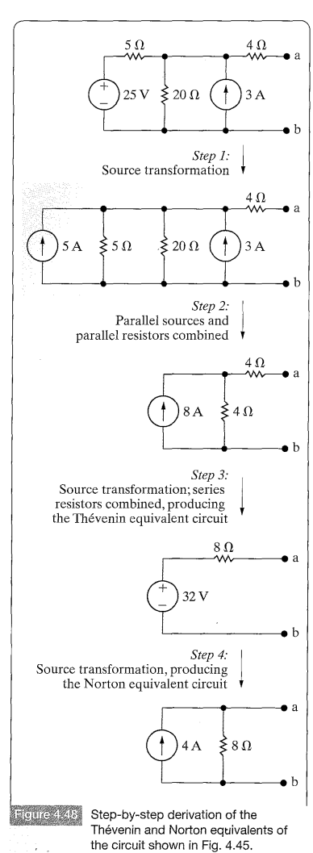
USING SOURCE TRANSFOMATIONS TO DETERMINE THE THEVENIN OR NORTON EQUIVALENT CIRCUIT.
Sometimes effective use of source
transformations can be made to derive a
Thevenin or a Norton Equivalent circuit.For
example,we can derive the Thevenin and
Norton equivalents of the circuit shown in
Figure 4.45,by making the series of
transformations shown in Figure 4.48.This
technique is most useful,when the network
contains only independent sources.The
presence of dependent sources requires
retaining the identity of the controlling
voltages and/or currents,and this constraint
usually prohibits continous reduction of the
circuit by source transformations.

Slide 15
USING SOURCE TRANSFOMATIONS TO DETERMINE THE THEVENIN OR NORTON EQUIVALENT CIRCUIT.
Example 4.10

Slide 16
MORE ON DERIVING A THEVENIN EQUIVALENT CIRCUIT
Two methods other than the method illustrated in section 4.10 are easier for determination of the Thevenin resistance RTh.The first of these methods is only applicable, if the network contains only independent sources.To calculate RTh for such a network,we first deactivate all independent sources and then calculate the resistance seen looking into the network at the designated terminal pair.
In order to deactivate a voltage source,we replace it with a short-circuit.A current source is deactivated by replacing it with an open circuit.

Slide 17
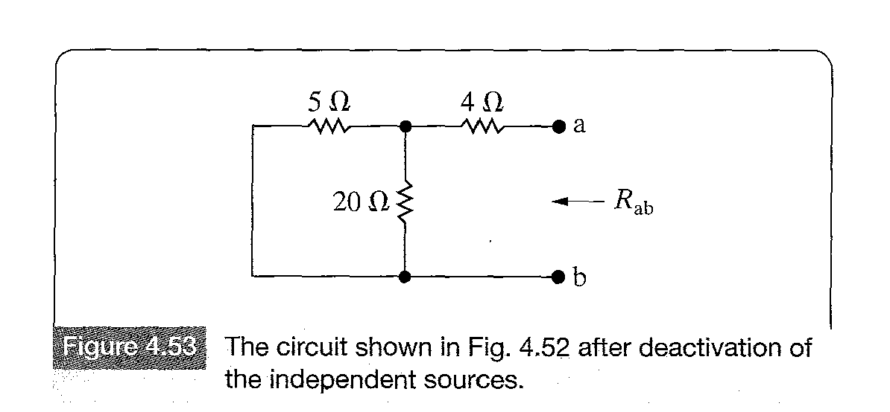

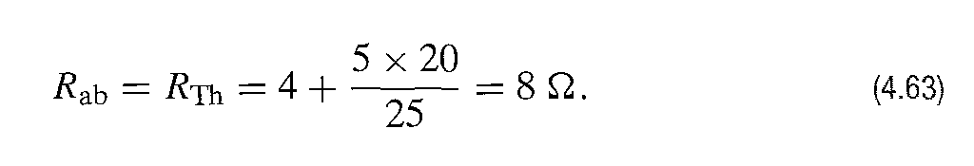
MORE ON DERIVING A THEVENIN EQUIVALENT CIRCUIT
The circuit shown in Figure 4.52 is transformed to the circuit in Figure 4.53,when all independent sources are deactivated.
The resistance seen looking into the terminals a,b is denoted Ra,b and consists of the 4 resistor in series with parallel combination of the 5 and 20 resistors.Thus

Slide 18
MORE ON DERIVING A THEVENIN EQUIVALENT CIRCUIT
If the circuit contains dependent sources,an alternative way of finding the Thevenin resistance is as follows:First all independent sources are deactivated,next either a test voltage source or a test current source is applied to the Thevenin terminals a,b.
The Thevenin resistance equals the ratio of the voltage across the test source to the current delivered by the test source.Example 4.11 illustrates this alternative procedure for finding RTh,using the same circuit as Example 4.10.

Slide 19
MORE ON DERIVING A THEVENIN EQUIVALENT CIRCUIT
Example 4.11

Slide 20
MAXIMUM POWER TRANSFER
Circuit analysis is very important in all systems designed to transfer power from a source to a load.Power transfer in terms of two basic types of systems will be considered.
The first type of systems try to maximize the efficiency of the power transfer.Power utility systems are good examples of such systems.These systems are concerned with the generation,transmission and distribution of large amounts of power.
Efficiency of such systems is important,as the power losses during the generation,transmission and distribution processes limit the amount of power that reaches the end users.

Slide 21
MAXIMUM POWER TRANSFER
The second types of systems try to maximize the amount of power transferred.
Communication and instrumentation systems are good examples of such systems,because in the transmission of information,or data,via electric signals,the power available at the transmitter or detector is limited.Thus maximizing the power transferred to the receiver or load is desirable.
Next we consider maximum power transfer in purely resistive circuits.We assume that there is a resistive network containing both dependent and independent sources and a designated pair of terminals a,b at which the load RL is to be connected.

Slide 22
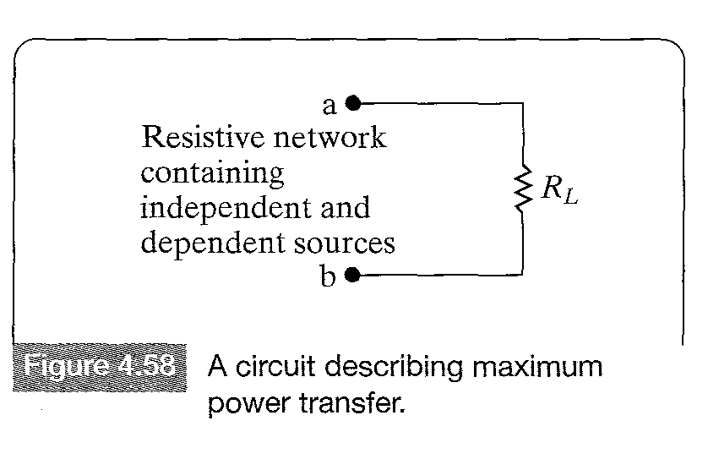
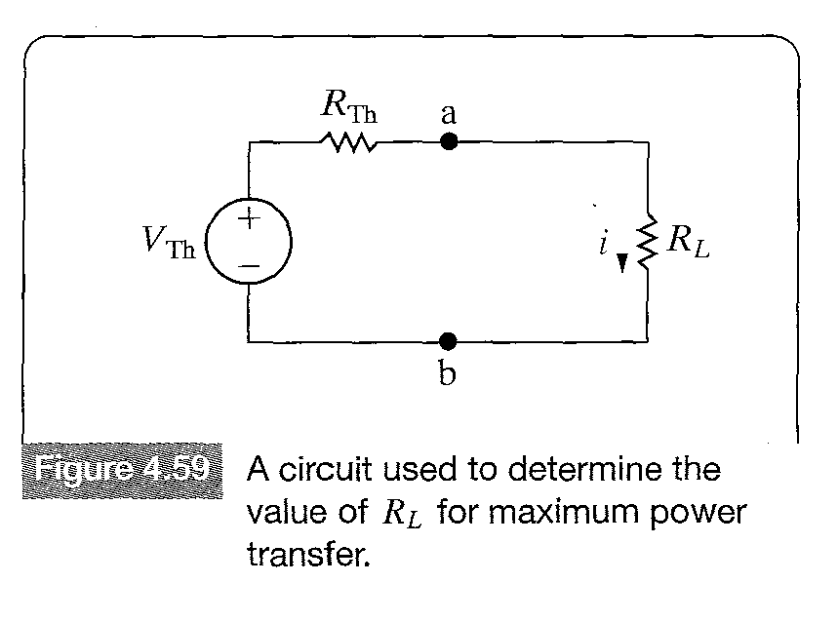
MAXIMUM POWER TRANSFER
The problem is to determine the value of RL that allows the maximum power delivery to RL.
We first replace the the circuit left of terminals a,b by its Thevenin Equivalent.

Slide 23
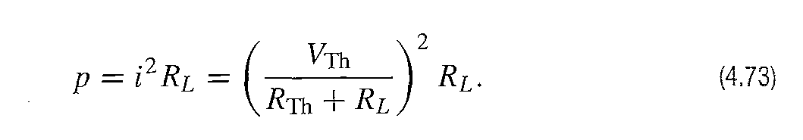
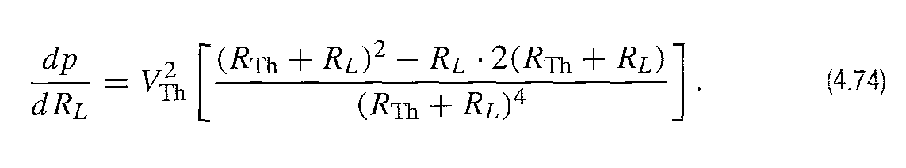
MAXIMUM POWER TRANSFER
Thus, the determination of RL requires expressing the power dissipated by RL as a function of the three circuit parameters VTh,RTh and RL.Thus
For a given circuit the values of VTh and RTh will be fixed.Therefore the power dissipated is a function of only RL.
To find the value of RL that maximizes the power,we take its derivative and set it equal to zero.

Slide 24
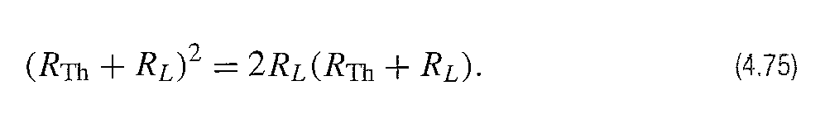
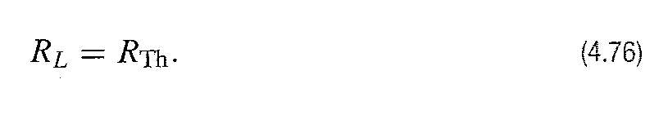
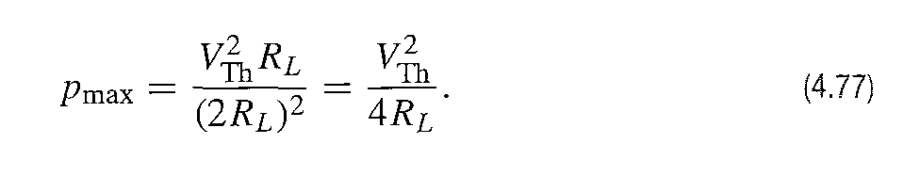
MAXIMUM POWER TRANSFER
The derivative is zero and the power is maximized,when
Solving equation 4.75 yields
The results above indicate that the maximum power transfer occurs when the load resistance RL equals the Thevenin resistance RTh.To find the maiximum power transferred to the load,we simply substitute Equation 4.76 into 4.73
Example 4.12 describes the analysis of a circuit when the load resistor is adjusted for maximum power transfer.

Slide 25
MAXIMUM POWER TRANSFER
Example 4.12

Slide 26
SUPERPOSITION
A linear system satisfies the principle of superposition which states that the total response of a circuit due to several voltage or current sources is equal to the sum of the responses due to each source alone.
When a circuit is driven by more than one independent source,the superposition principle can be used to find the total response of the system,by supressing all sources except one and finding the response due to the source kept and repeating this process for all sources.Finally, by adding the individual source responses the total response of the system is found.

Slide 27
SUPERPOSITION
Superposition is applied in both the analysis and design stages of circuits.
Superposition is applied only if the dependent sources in a circuit are fundamentally different.That is some one of them are d.c sources and some others a.c sources.
In these early chapters all independent sources are dc sources,so superposition is not necessary.
We demonstrate it here in the expectation of later chapters,in which circuits need it for analysis.
In circuit design superposition is applied when a circuit response cannot be synthesized in a circuit with a single source.

Slide 28
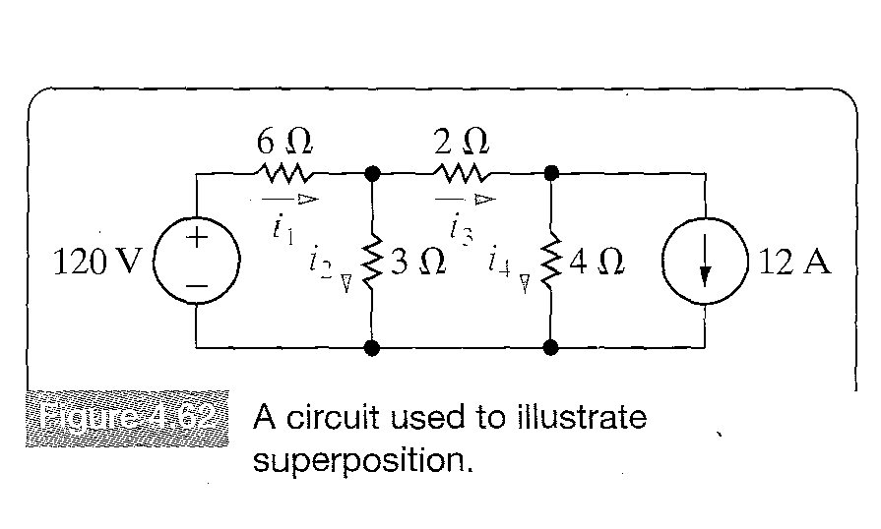
SUPERPOSITION
Superposition is demonstrated using the circuit of Figure 4.62 below.
We begin by finding the branch currents due to the 120 V voltage source alone.Thus the 12A ampere source is eliminated from the circuit by replacing it with an open circuit and the following circuit is obtained.

Slide 29
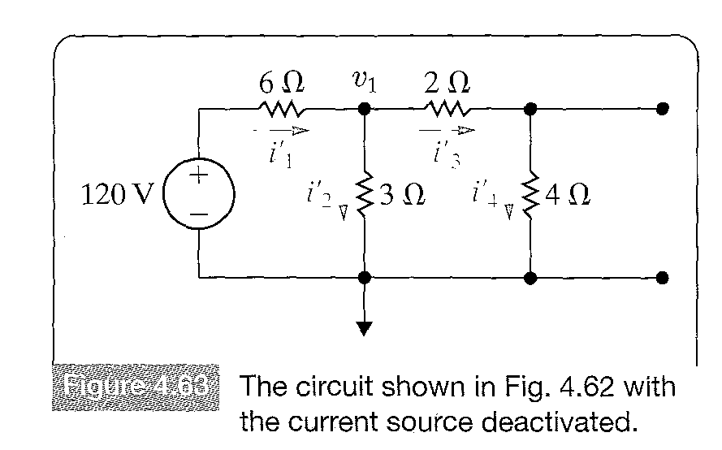
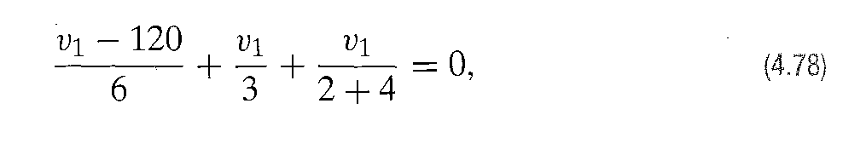

SUPERPOSITION
We denote the branch currents with prime and note that once v1 is known all of them can be determined. Solving the node voltage equations to determine v1 we get:
From which

Slide 30
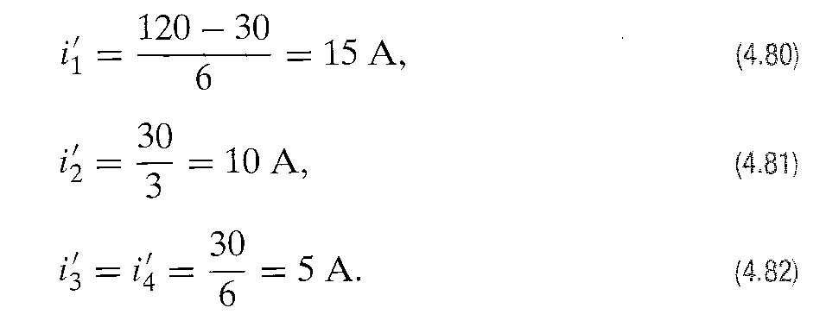
SUPERPOSITION
Next the branch currents can be found using v1 and the known values of the resistances and the voltage source.

Slide 31
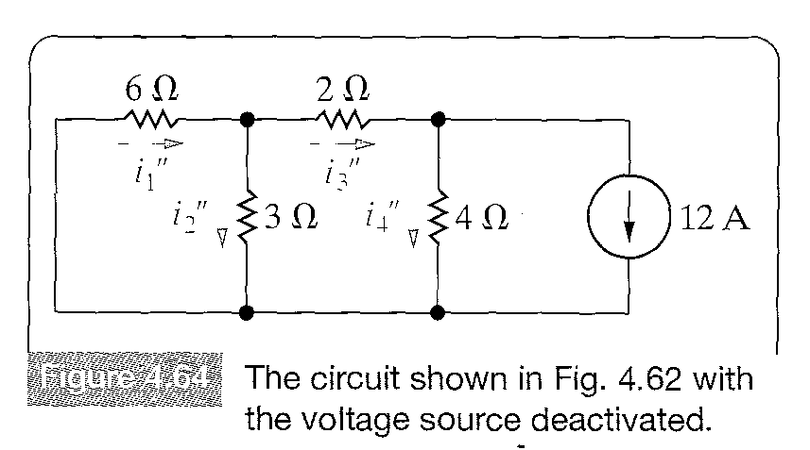
SUPERPOSITION
To find the components of the branch currents resulting from the current source,we deactivate the ideal voltage source by replacing it with a short circuit and solve the circuit shown in Figure 4.64.
The double prime notation indicates that the currents are due to the 12 A ideal current source.

Slide 32

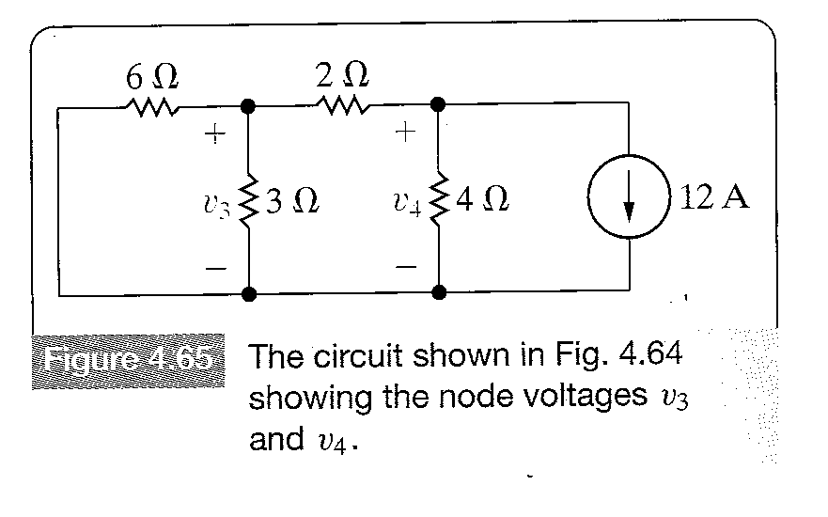
SUPERPOSITION
The branch currents in the circuit shown in Figure 4-64 are determined by first solving for the node voltages across the 3 and 4 resistors respectively.Figure 4.65 shows the node-voltage equations.

Slide 33
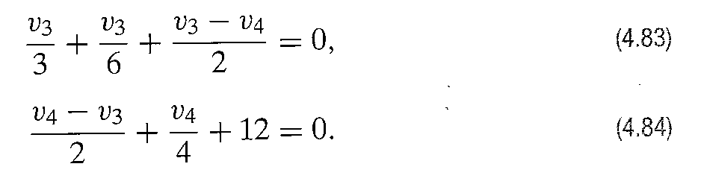
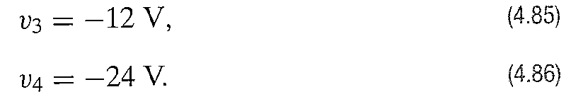
SUPERPOSITION
The node-voltage equations that describe the circuit are.
Solving equation 4.83 and 4.84 for v3 and v4,we get

Slide 34
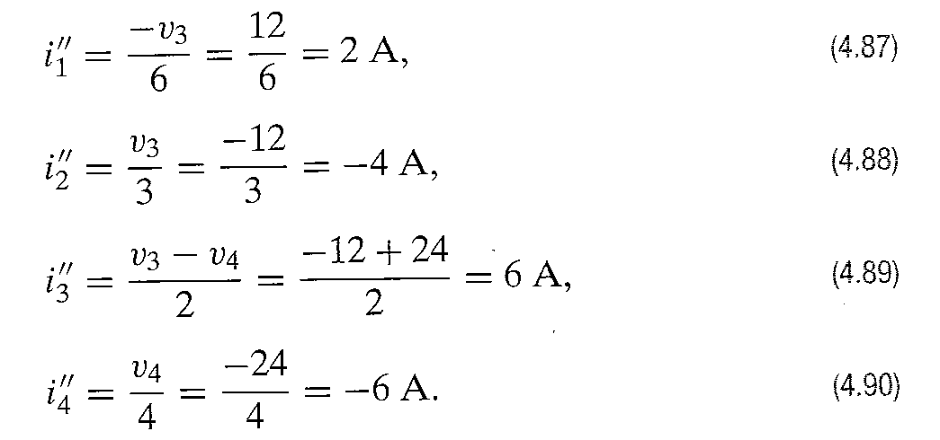
SUPERPOSITION
Now the branch currents can be found using the node voltages.

Slide 35
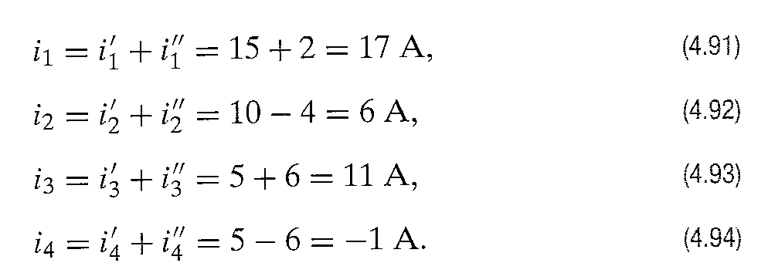
SUPERPOSITION
To find the branch currents in the original circuit,we simply add the currents given by Equations 4.87-4.90 to the currents given by Equations 4.80-4.82.
Note,when applying superposition to linear circuits containing both independent and dependent sources,the dependent sources are never deactivated.

